Slide 1
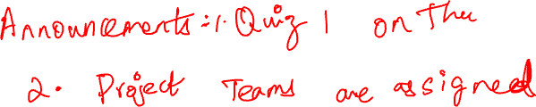
Data Visualization: Chapter 11
CS 418 Introduction to Data Science
Prof. Sathya Ravi
September 24, 2024

Slide 2
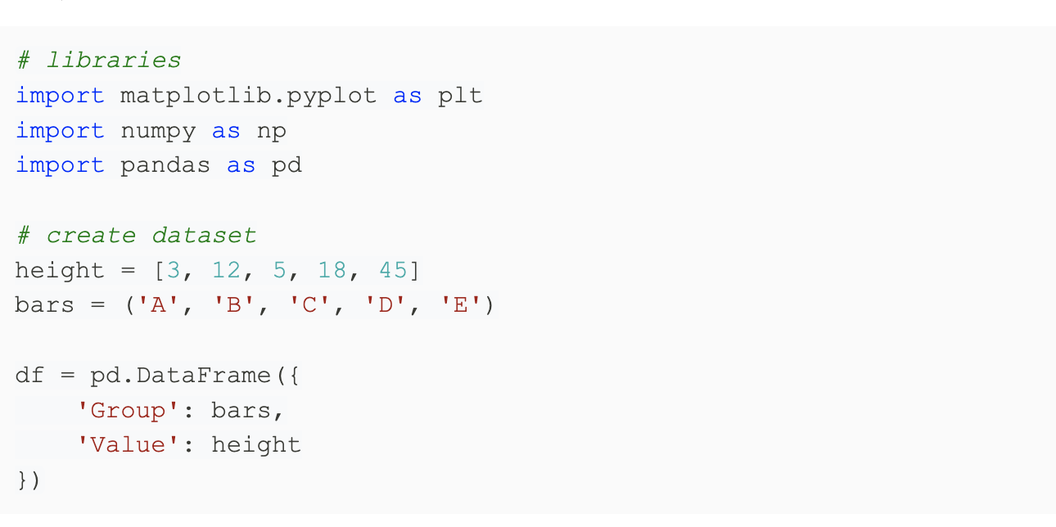
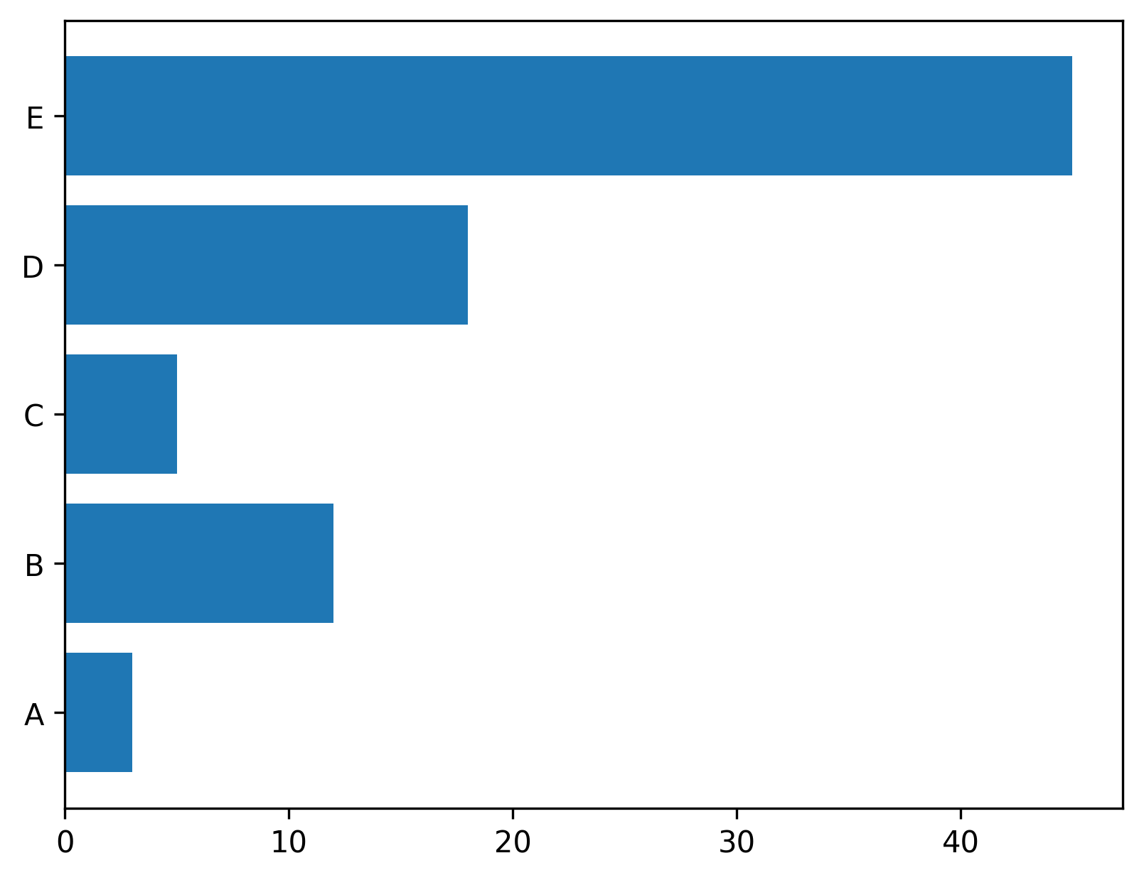
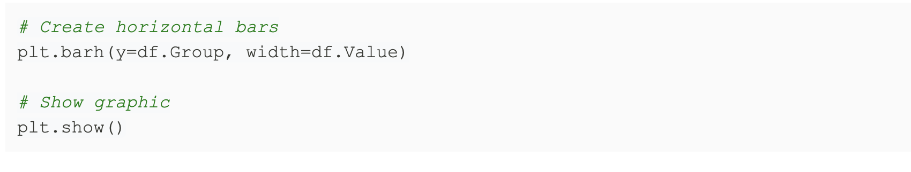

Basic Implementation in Python

Slide 3
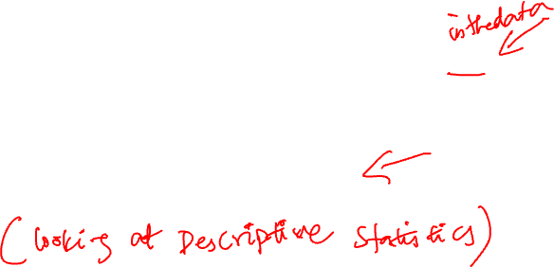
TWO TYPES OF VISUALIZATION
Data exploration visualization: figuring out what is true
Data presentation visualization: convincing other people it is true (usually they are related)
This lecture will mostly be focused on the first
“Data exploration” (or EDA) is much broader than just visualization

Slide 4

IMPORTANCE OF VISUALIZATION
Before you run any analysis, build any machine learning system, etc., always understand your data
If you can’t identify a trend or make a prediction for your dataset, neither will an automated algorithm (without huge amounts of data)
This is especially important to keep in mind as you hear stories of “superhuman” performance of AI methods (it is possible, but takes a lot of time/data, and is not the norm)
Visualization will also give you ideas how to represent/clean your data better
For the performance of ML algorithms, the right pre-processing and cleaning can be more important than which specific algorithm you choose

Slide 5
REVIEW OF PLOT TYPES

Slide 6
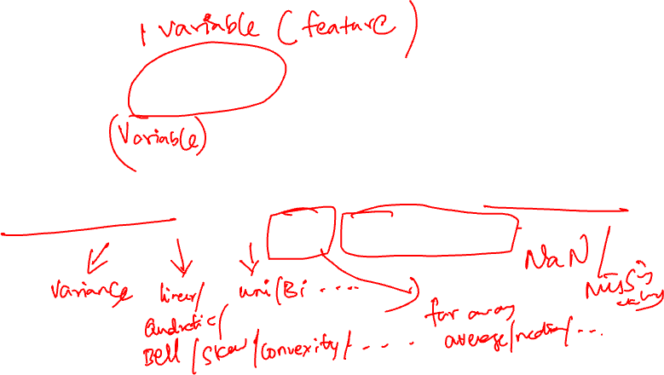
VISUALIZING UNIVARIATE RELATIONSHIPS
Quantitative Data
Histograms, Box Plots, Rug Plots, Smoothed Interpolations (KDE – Kernel Density Estimators)
Look for: spread, shape, modes, outliers, unreasonable values …
Categorical Data (Nominal & Ordinal)
Bar plots (sorted by frequency or ordinal dimension)
Look for: skew, frequent and rare categories, or invalid categories
Consider grouping categories and repeating analysis

Slide 7
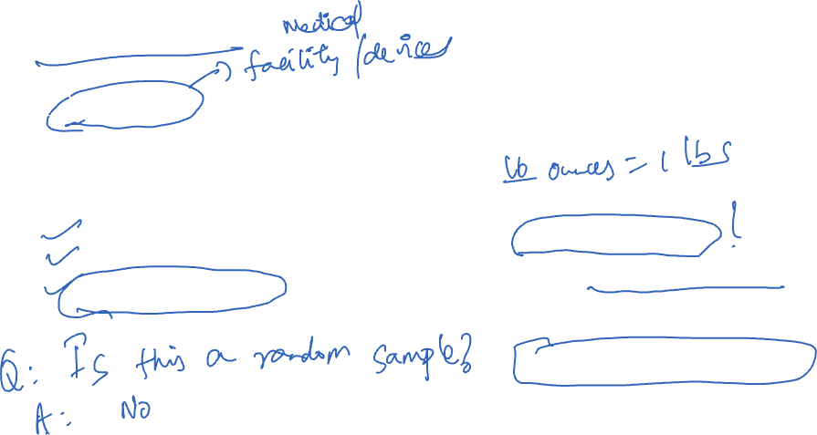
KAISER STUDY
Oakland Kaiser mothers
1960s
Measure the babies weight (in ounces) at birth
All babies:
Male
Single births (no twins, etc.)
Survived at least 28 days
Data provenance:
Mothers who use Kaiser
Starts as administrative dataset, expanded into study with new data
Selection mechanism not random
Notes:
Data available from Prof. Nolan’s statlab project that provides many examples and case studies in statistics.
Q: is it a simple random sample?

Slide 8
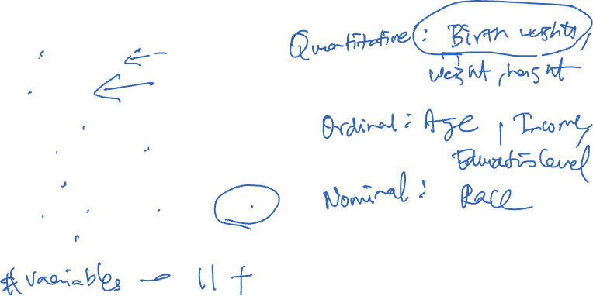
INFORMATION COLLECTED ON MOTHERS AND THEIR BABIES
Birth weight (ounces)
Gestation (weeks)
Parity - total number of previous pregnancies
Mother’s height and weight
Mother’s smoking status
Mother’s age, race, education level, income
Father’s information and more…
Notes:
What kinds of data are these? Quantitative, ordinal or nominal.
Income: actually qualitative, b/c it’s reported in brackets, not absolute amounts.

Slide 9
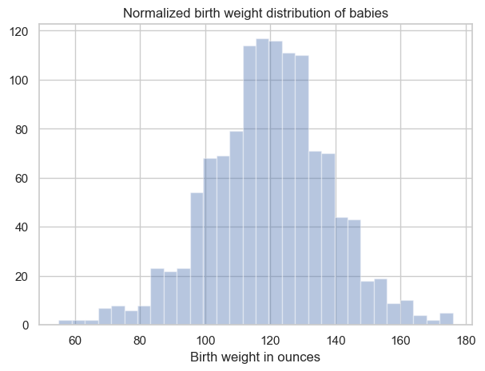
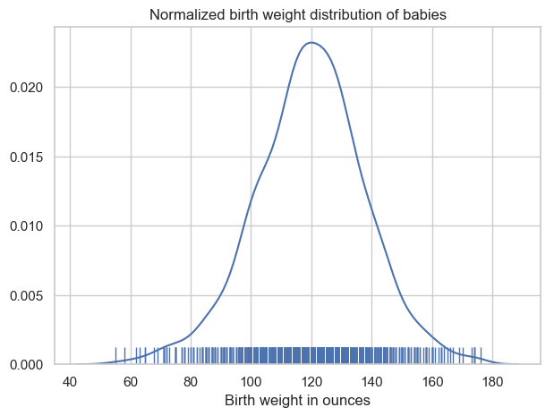
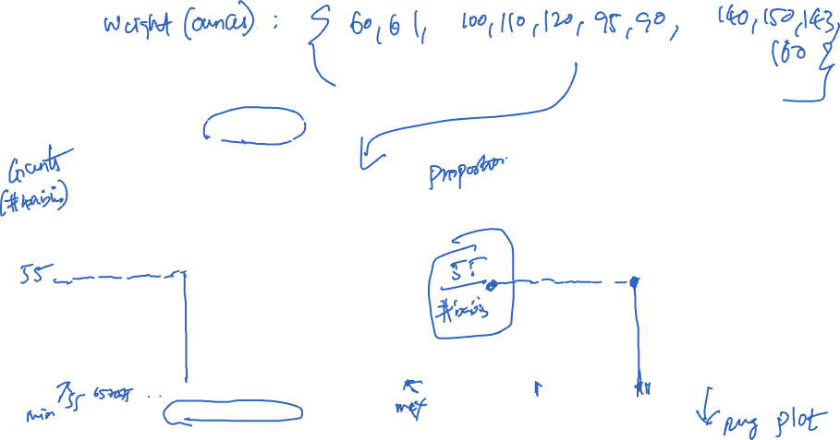
QUANTITATIVE VARIABLE: BIRTHWEIGHT
Histogram
Density Curve
How would we describe the distribution of birth weight?
Notes:
Properties of these data?
Modes? Basically unimodal.
Skew? Very little
Tails? Both short.

Slide 10
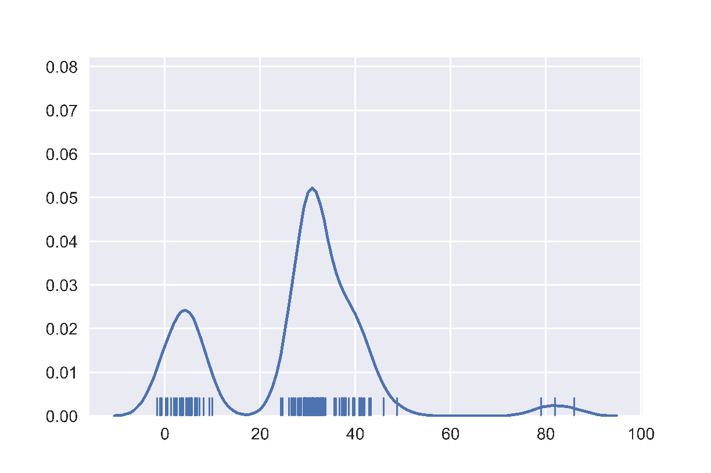
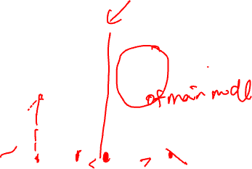
HISTOGRAMS, RUG PLOTS, KDE INTERPOLATION
Describes distribution of data – relative prevalence of values
Histogram
relative frequency of values
Tradeoff of bin sizes
Rug Plot
Shows the actual data locations
Kernel density estimator (KDE) plot
Tradeoff of “bandwidth” parameter (more on this later)
Main Mode
Smoothed Density Estimator
Second Mode
Skew Right
Histogram
Outliers
Gap
Rug
Note: this figure is not part of the Kaiser dataset

Slide 11
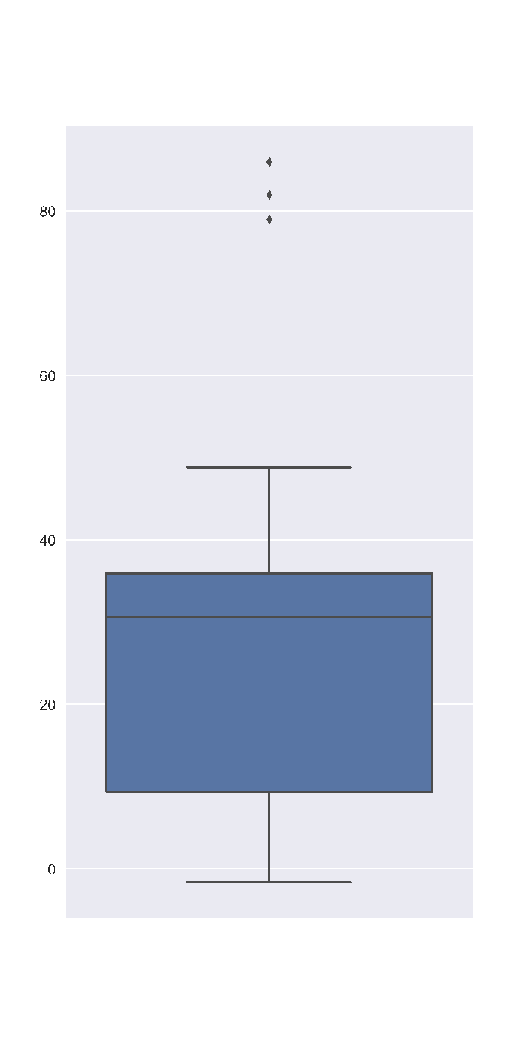
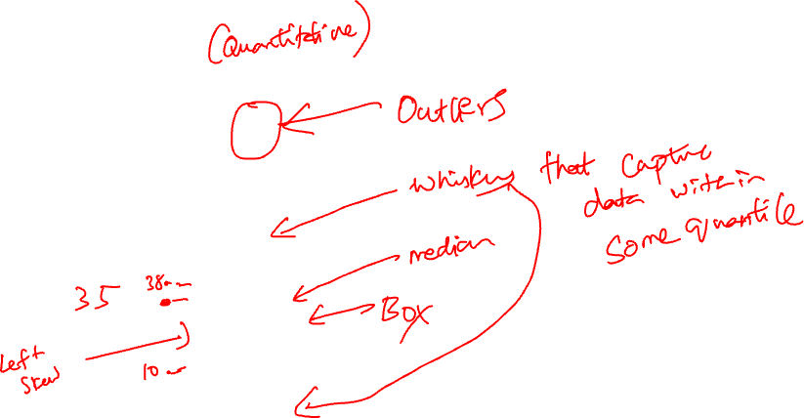
BOX PLOT/CHART
Useful for summarizing distributions and comparing multiple distributions
Outliers
Outliers are > 1.5 * IQR away from lower and upper quartiles.
(in some implementations, others use 3*IQR, …)
Whisker
Upper Quartile
Interquartile
Range (IQR)
50% of Data
Median
Lower Quartile
Notes:
Box plots are a convenient way to see where most of the data lie. Typically, we use the 25th and 75th percentiles of the data as the start and endpoints of the box and draw a line within the box for the 50th percentile (the median). We draw two "whiskers" that extend to show the the remaining data except outliers, which are marked as individual points outside the whiskers. Whiskers end at the min and max values (again, excluding outliers)

Slide 12
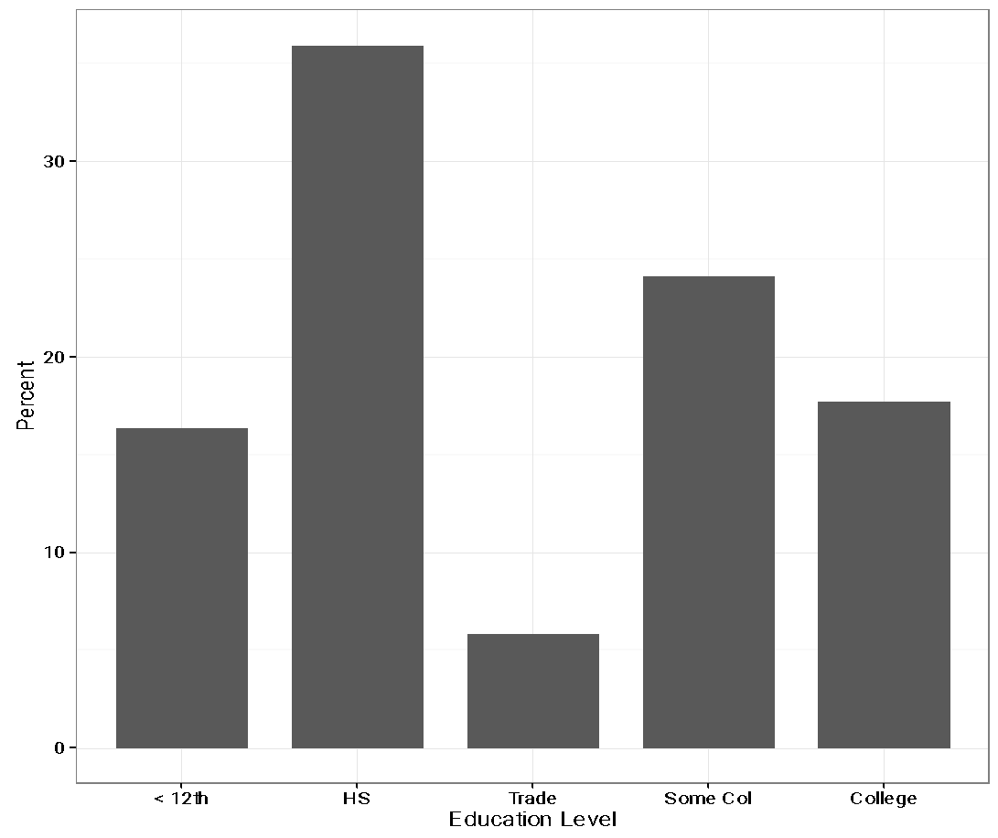
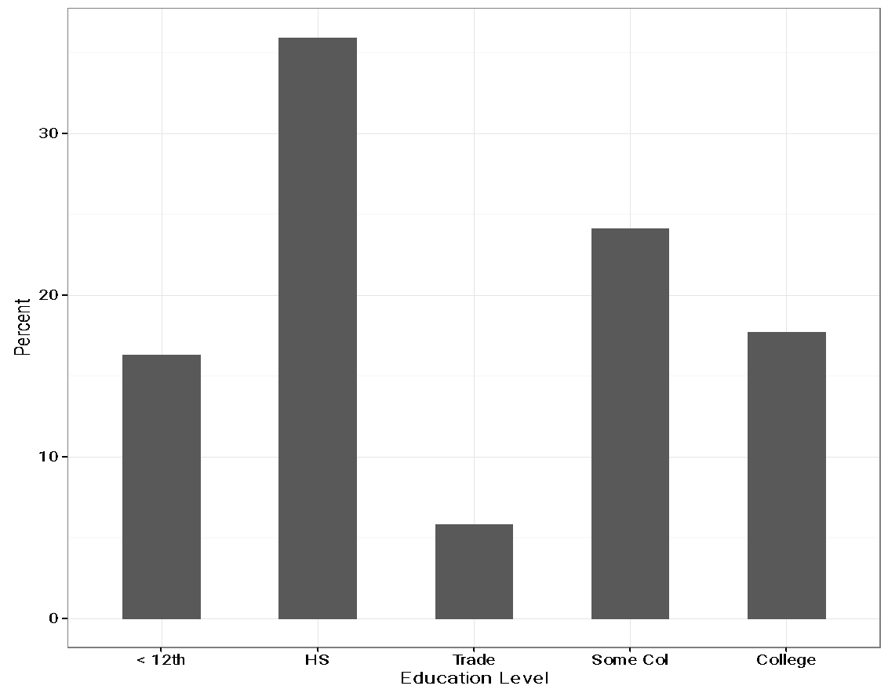
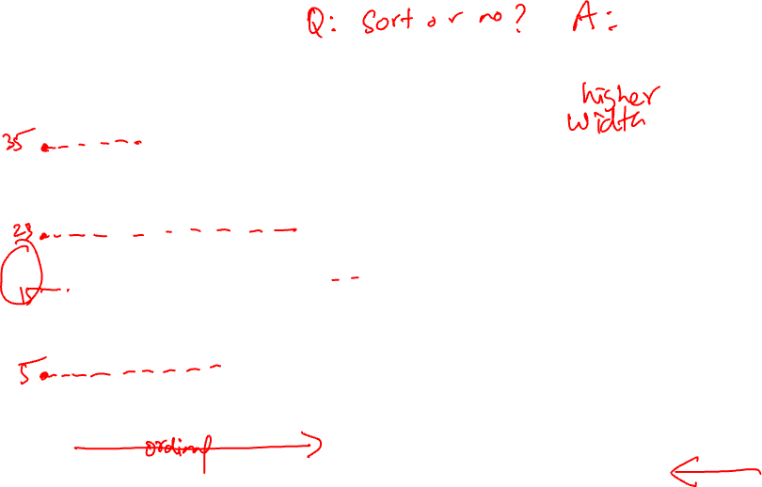
CATEGORICAL VARIABLE: EDUCATION LEVEL
Bar Width – has no meaning
Why don’t we reorder the bars from shortest to tallest?
Notes:
Bar chart – width of bar has no meaning
Bar chart – often prefer proportions or percentages over counts

Slide 13
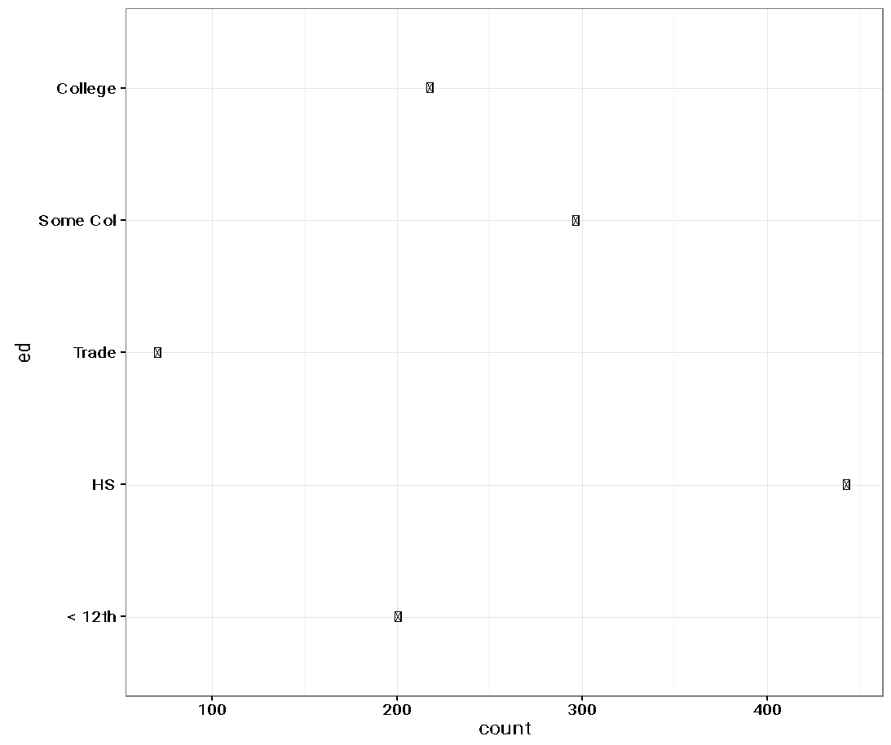
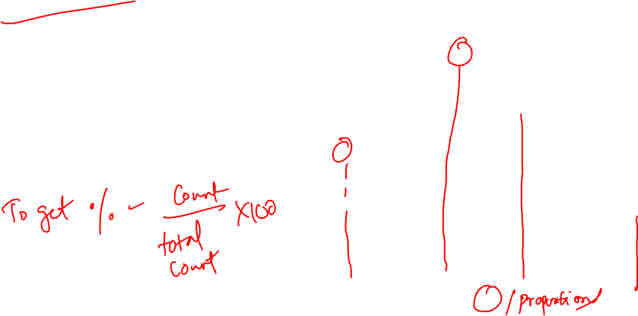
DOT PLOT/CHART
Width of bars in a bar plot have no meaning
Dot plot (aka Cleveland) focus on comparison of the values
Notes:
Dot

Slide 14
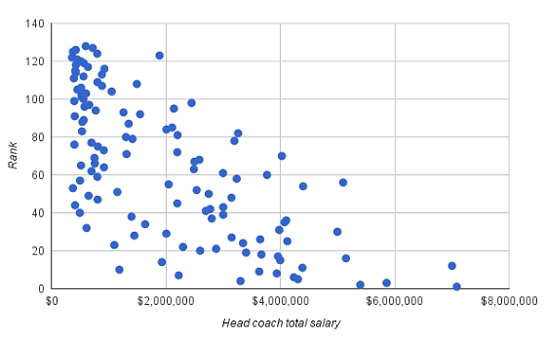
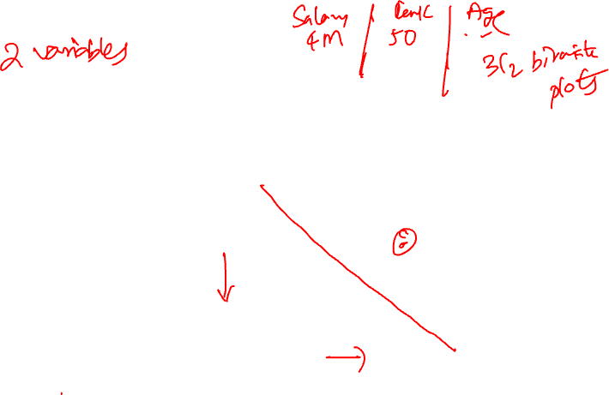
VISUALIZING BIVARIATE RELATIONSHIPS
Scatter plot uncovers form of relationship between 2 quantitative variables
Linear relationships are particularly simple to interpret
Simple and elegant statistical theory for linear relationships
Models are typically approximations, choose a simpler model over a complex one
Note: this figure is not part of the Kaiser dataset
Notes:
Scatter plots depict the relationship between two variables on a rectangular coordinate system, where each axis corresponds to one variable.
College football Head coach total salary vs. rank of team (1 is best team)

Slide 15
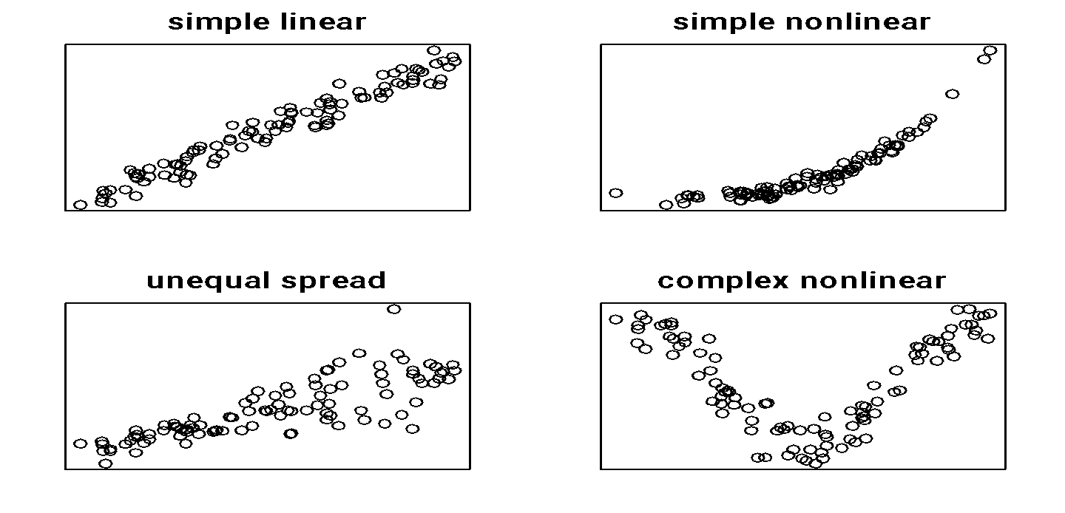
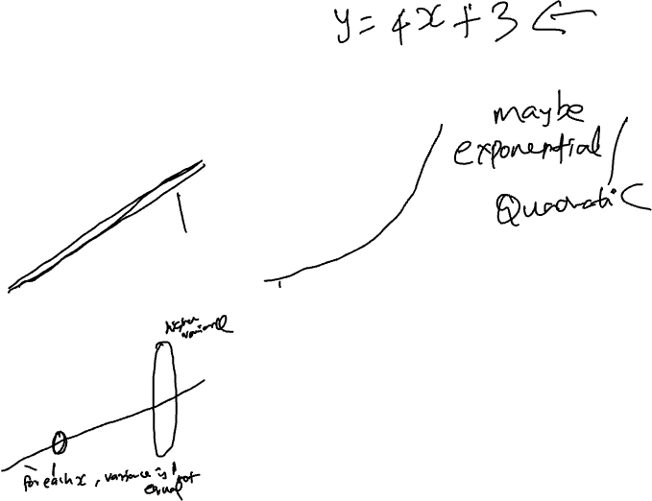
SCATTER PLOTS
Note: this figure is not part of the Kaiser dataset

Slide 16
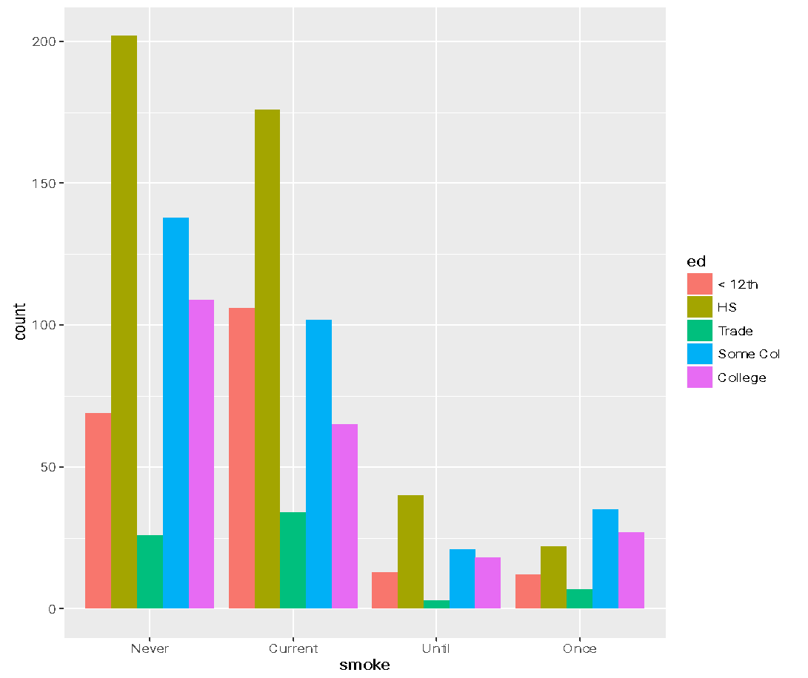
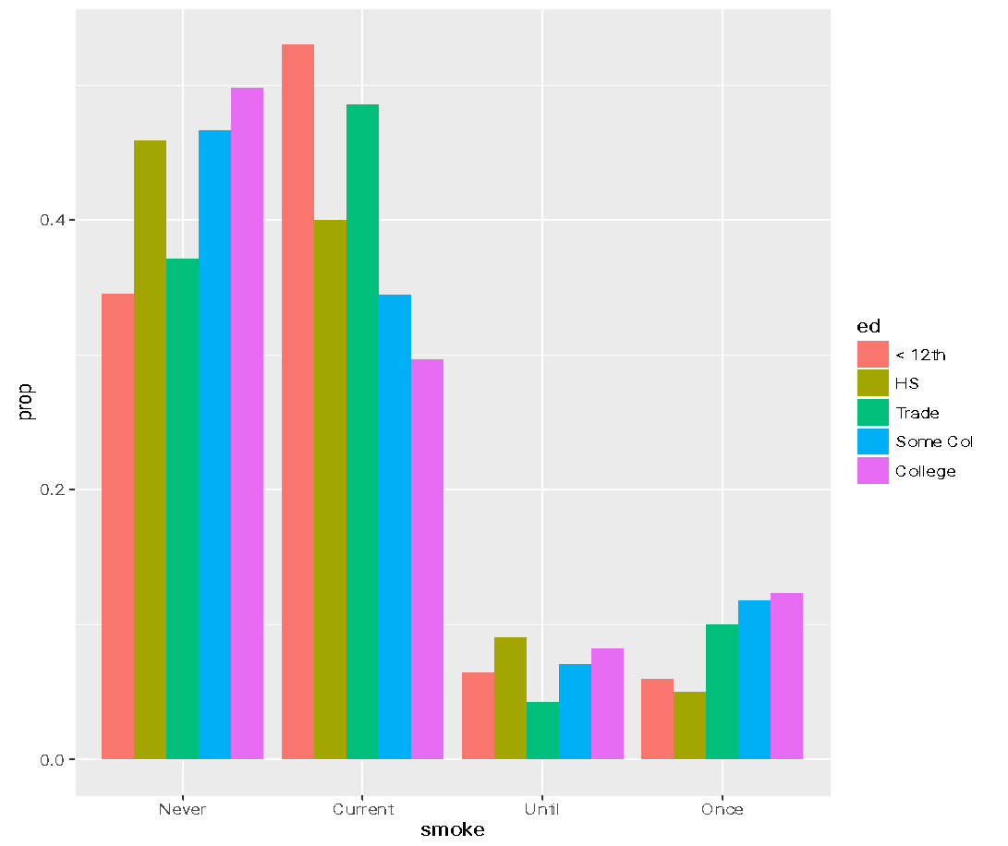
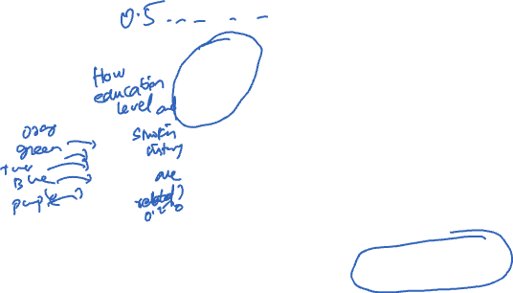
PAIRS OF CATEGORICAL VARIABLES
Side-by-side Bar Plot
Smoking status normalized within Education level
What’s the difference between these 2 plots?
Notes:
Count vs proportion – neither is “right”, but they convey different information.

Slide 17
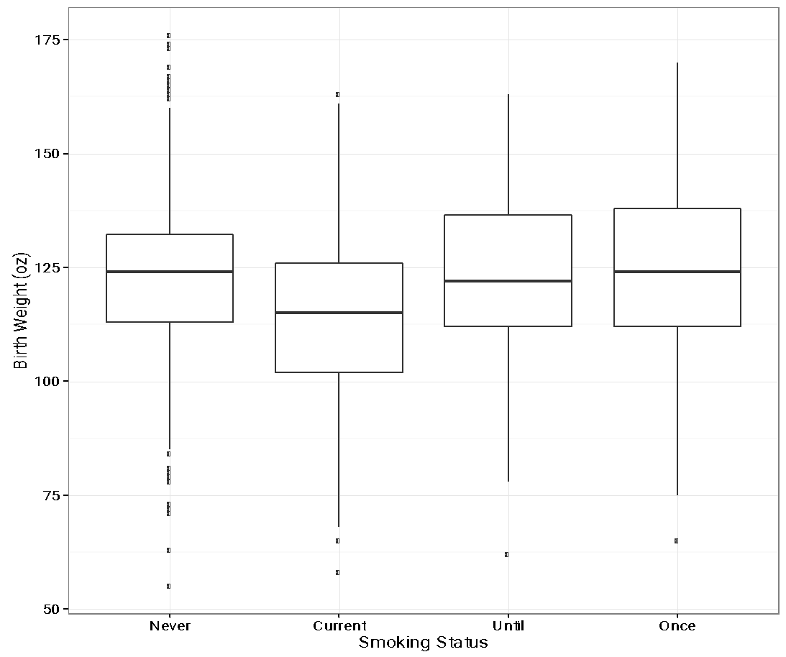
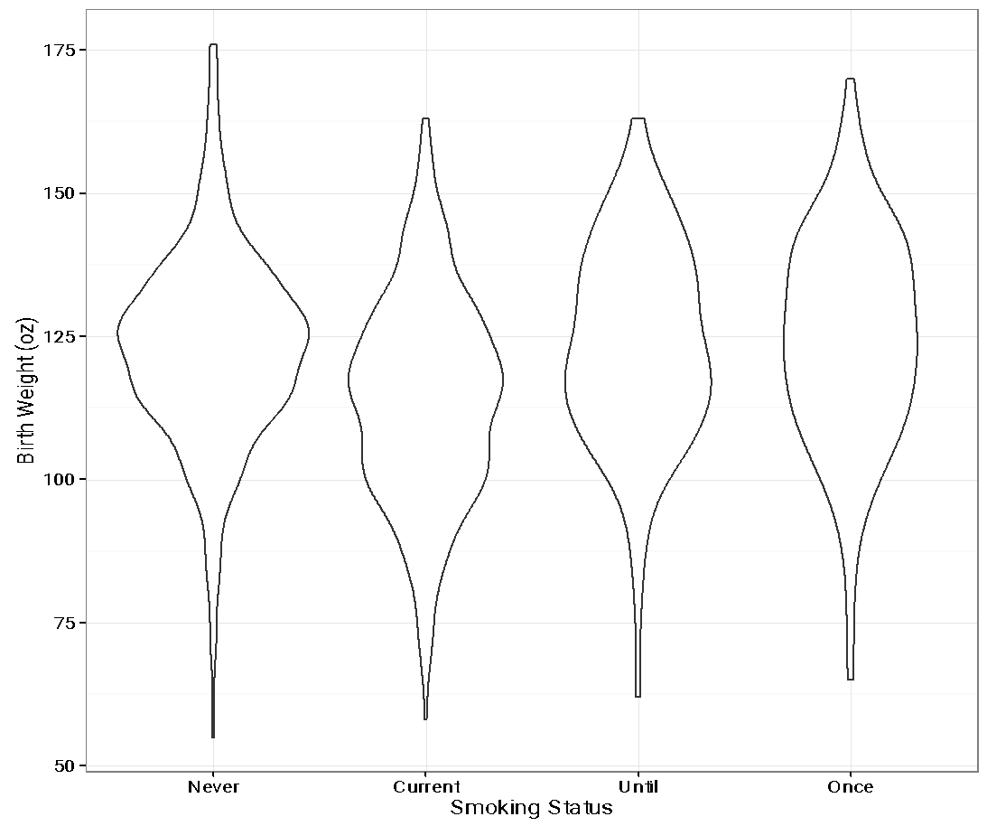
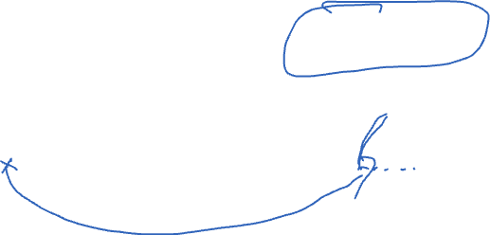
MIX QUANTITATIVE & CATEGORICAL
Side-by-side Box plots
Side-by-side violin plots
A violin plot is a hybrid of a box plot and
a kernel density plot, which shows peaks in the data.
Notes:
Outliers are > 1.5 * IQR away from lower and upper quartiles.
A violin plot is a hybrid of a box plot and a kernel density plot, which shows peaks in the data.

Slide 18
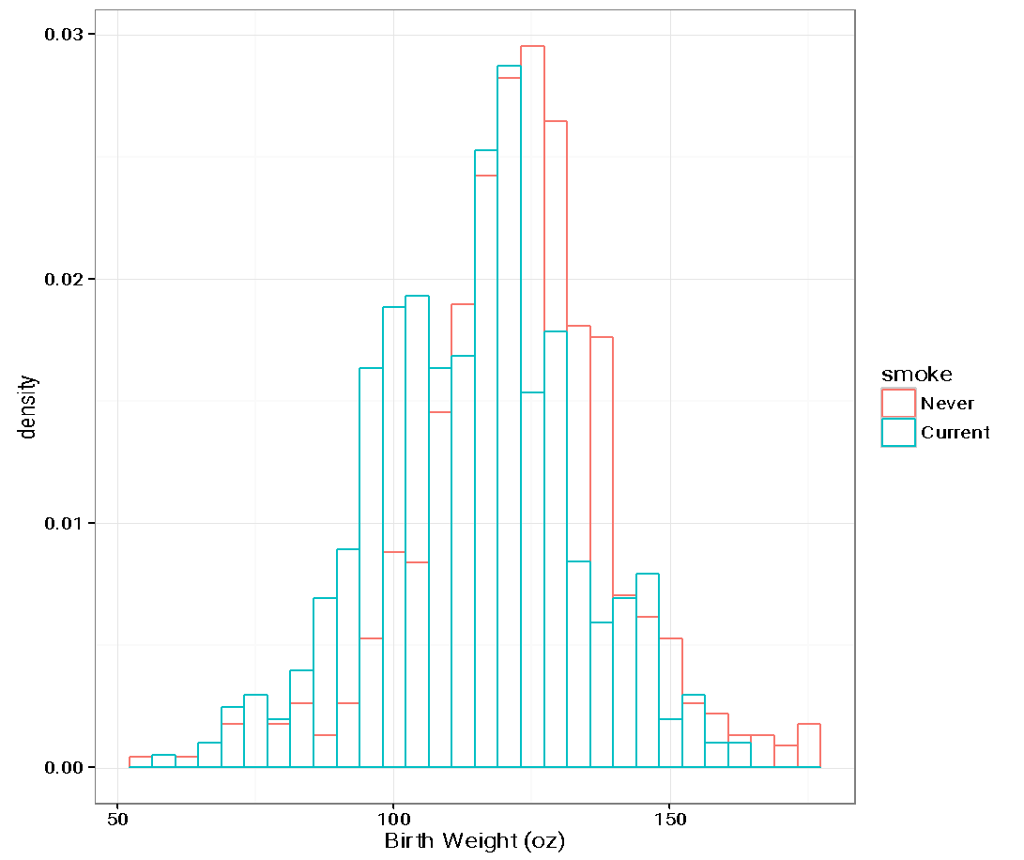
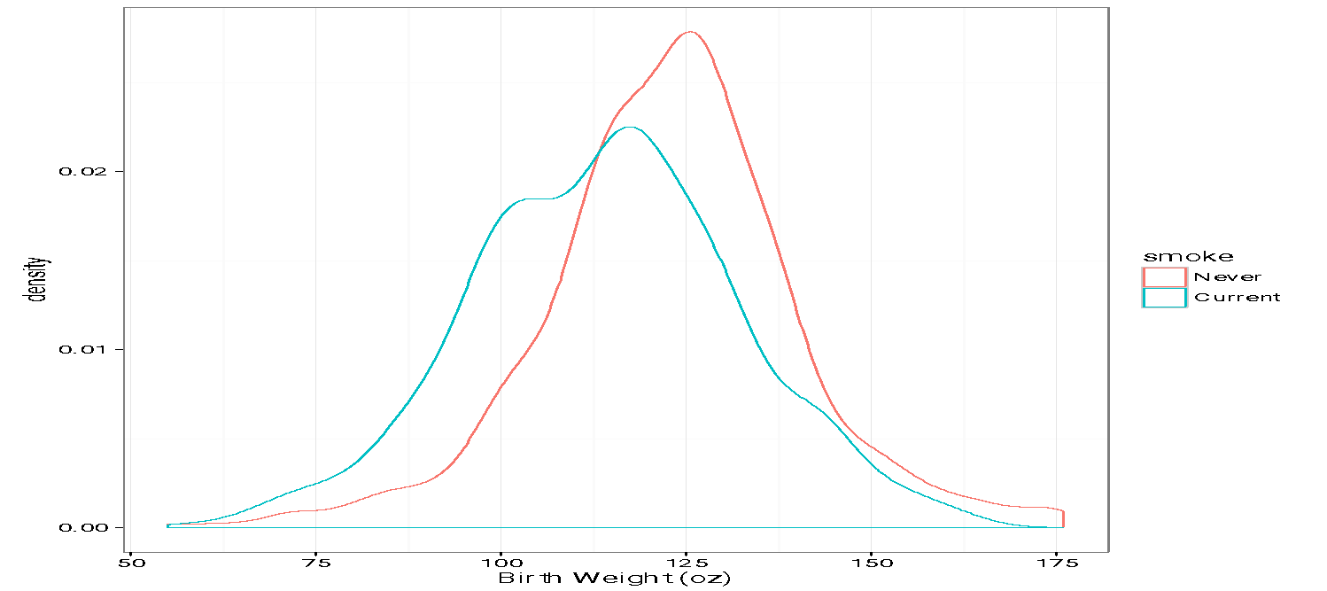
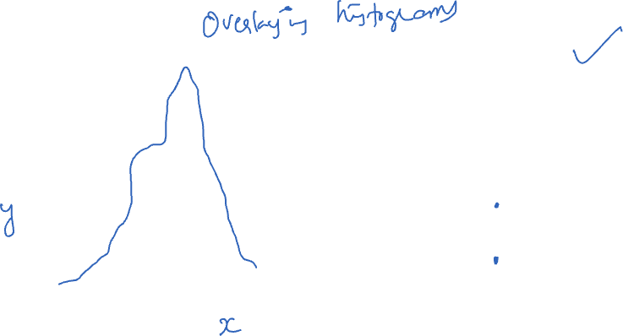
MIX CATEGORICAL & QUANTITATIVE
Overlaid histogram/curves

Slide 19
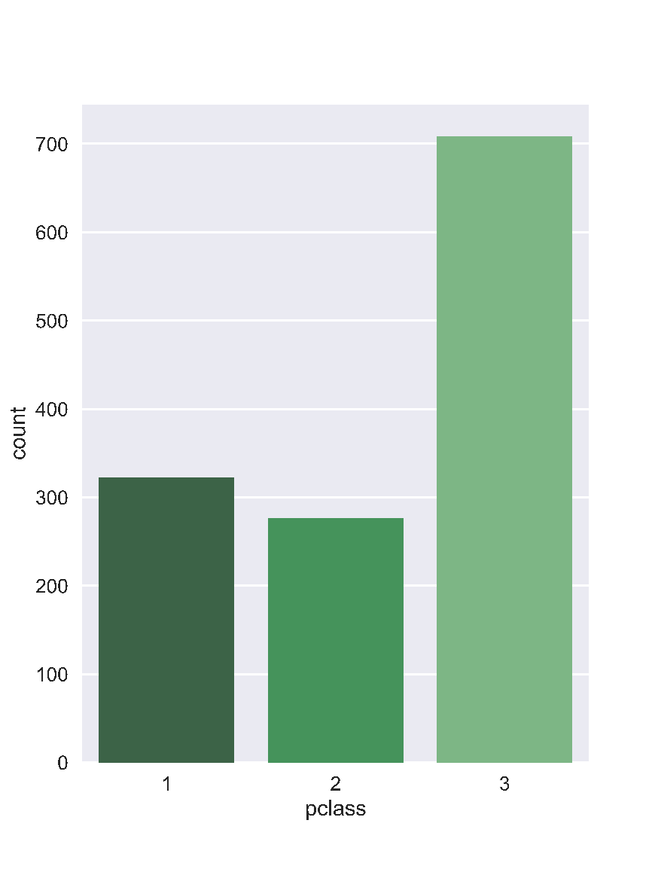
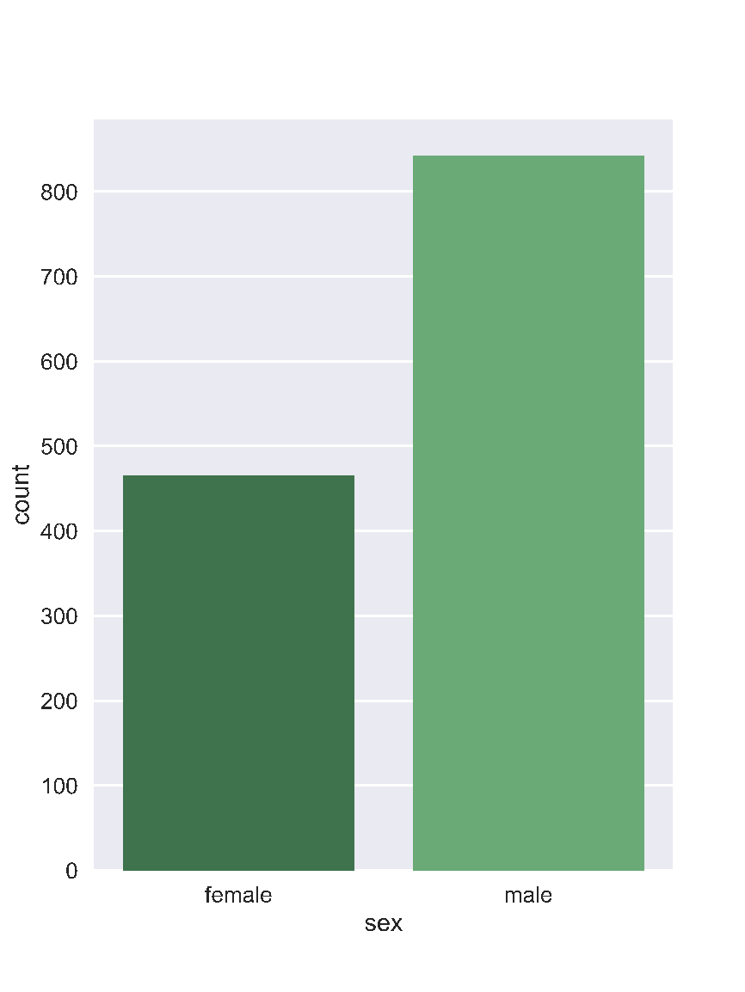
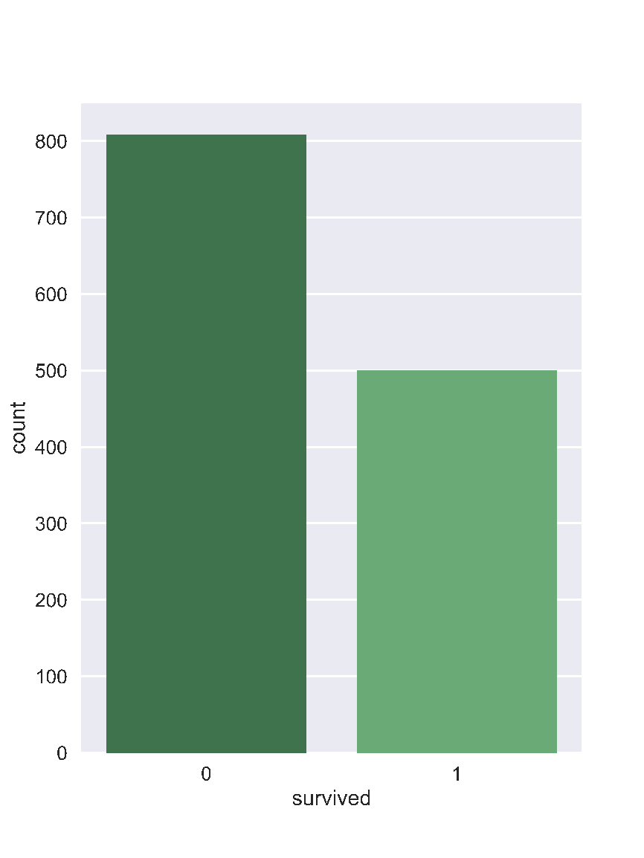

UNIVARIATE (VS. MULTIVARIATE)
Another example: three univariate plots
Titanic
Passenger
Manifest
Class
Sex
Survived

Slide 20
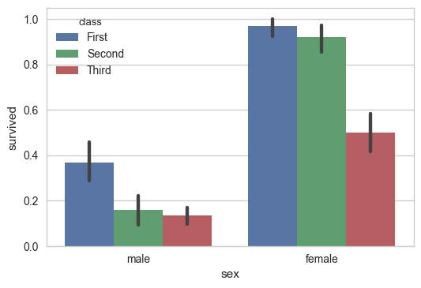
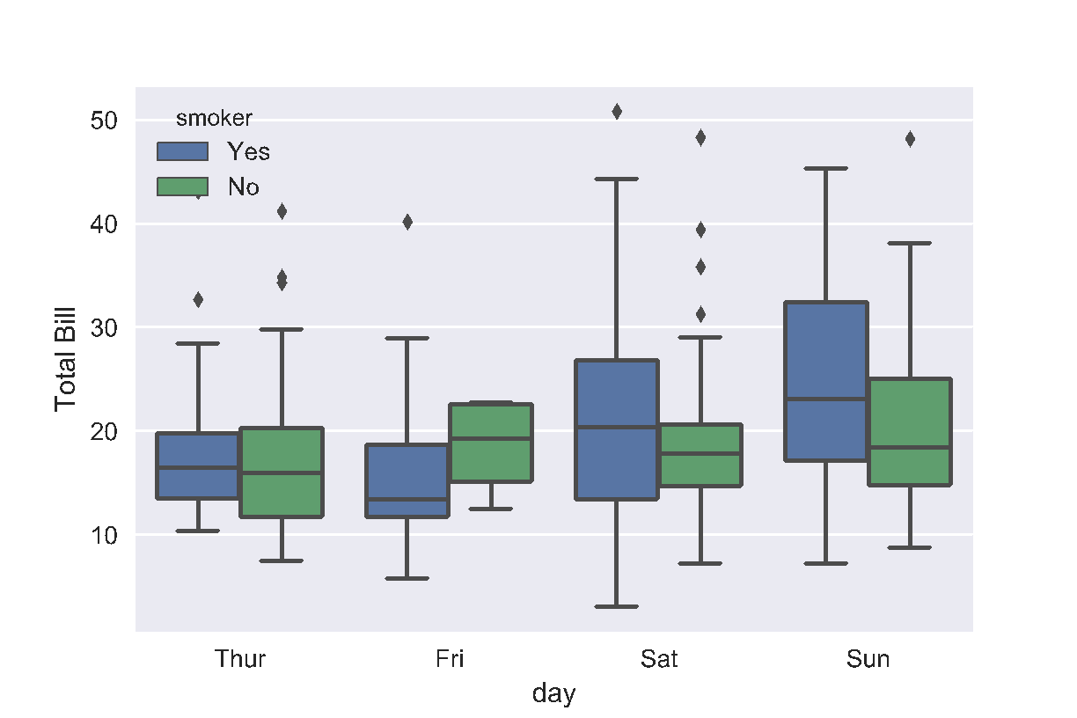
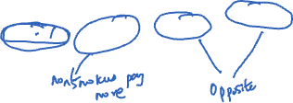
(UNIVARIATE VS.) MULTIVARIATE
Conditioning on a range of values (e.g., ages in groups) and construct side by side bar charts or box plots
Comparison of Restaurant Bills
Titanic Survivors
Notes:
Friday non-smokers seem to have higher bills

Slide 21
EXAMPLES OF PLOTS THAT NEED IMPROVEMENT

Slide 22

2015 CONGRESSIONAL HEARING: PLANNED PARENTHOOD
Congressman Chaffetz (R-UT), chair US House Oversight Committee
Investigation of federal funding of Planned Parenthood
Chaffetz showed a plot which originally appeared in a report by Americans United for Life (http://www.aul.org)
Notes:
The Committee on Oversight and Reform is the main investigative committee in the U.S. House of Representatives. The Committee's government-wide oversight jurisdiction and expanded legislative authority make it one of the most influential and powerful committees in the House. The Committee serves as Congress' chief investigative and oversight committee, and is granted broad jurisdiction.
Report available at:
https://oversight.house.gov/interactivepage/plannedparenthood

Slide 23
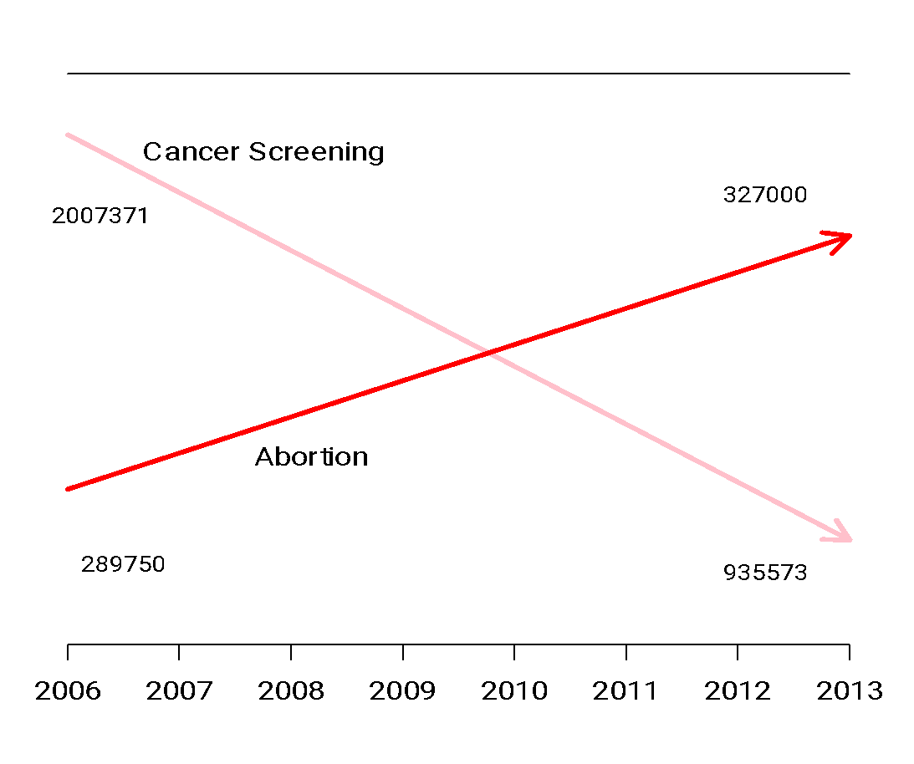
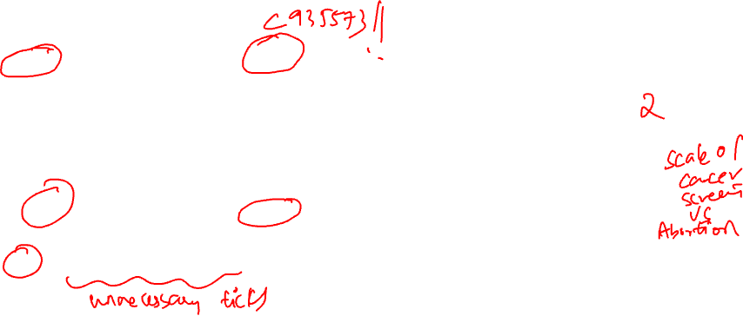
PLANNED PARENTHOOD PROCEDURES
Procedures:
Cancer screenings
Abortion
Time: 2006 to 2013
How many data points are in this plot?
What’s suspicious about this plot?
How can we improve this plot?
Note: This is based on an administrative dataset collected by Planned Parenthood
Notes:
Chapter 11: This plot violates principles of scale; it doesn't make good choices for its x and y-axis.
When we select the x and y-axis for our plot, we should keep a consistent scale across the entire axis. However, the plot above has different scales for the Abortion and Cancer Screening lines—the start of the Abortion line and end of the Cancer Screening line lie close to each other on the y-axis but represent vastly different numbers. In addition, only points from 2006 and 2013 are plotted but the x-axis contains unnecessary tick marks for every year in between.

Slide 24
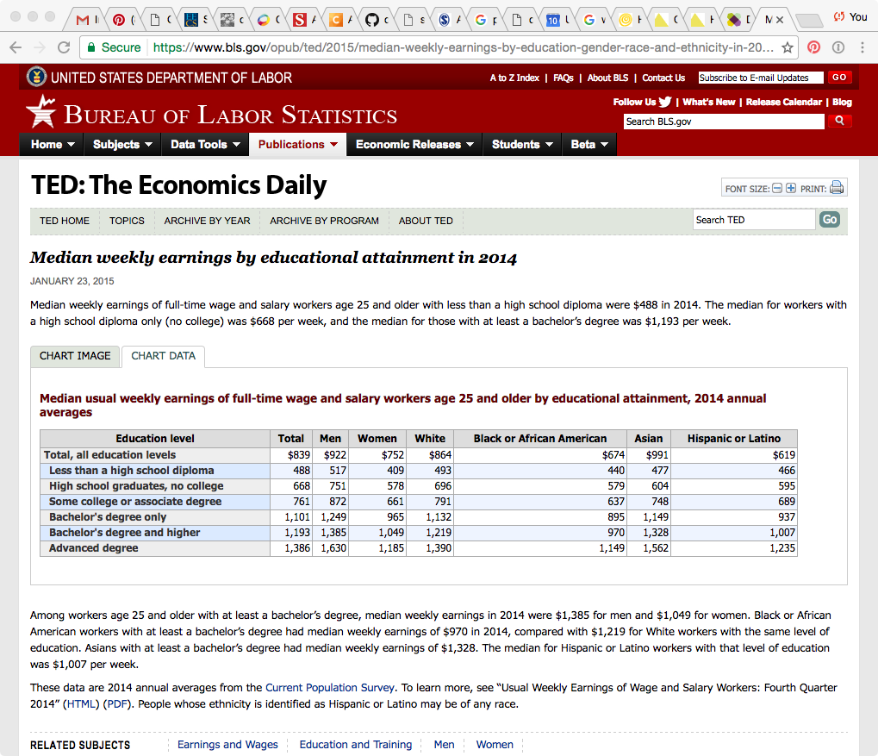
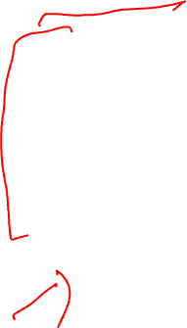
EARNINGS
Bureau of Labor Statistics
Oversees scientific surveys related to economic health of the country
Current Population Survey
Collects data on the earnings
www.bls.gov - Web interface to a report generating app

Slide 25
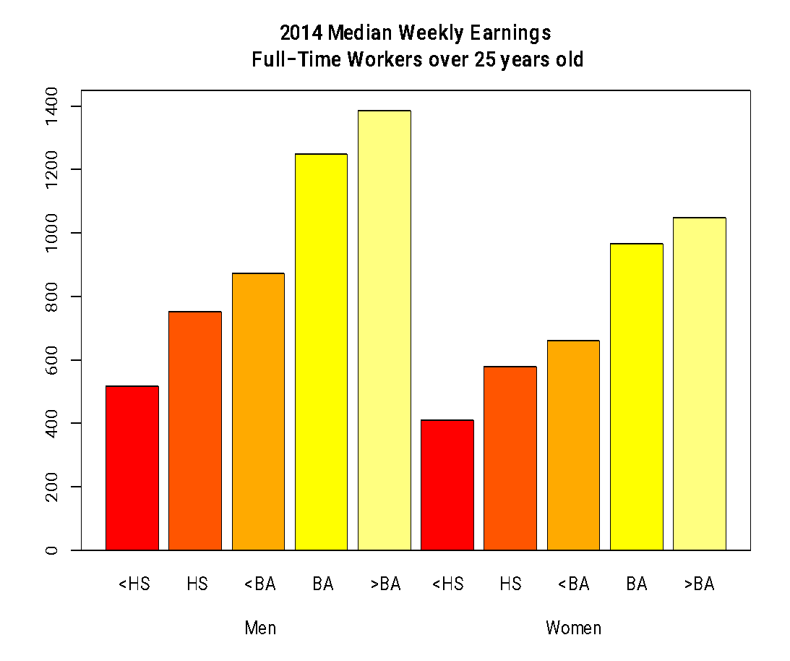
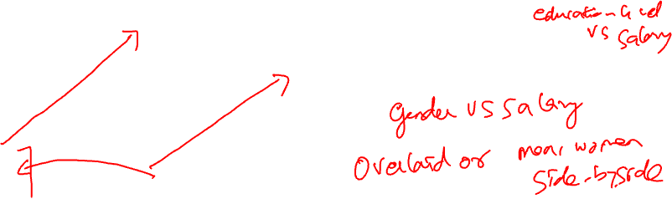
EARNINGS
Which comparisons can be easily made with this plot?
What comparisons are most interesting or important?
Note: This is a probability sample (AKA scientific sample)
Notes:
The US Bureau of Labor Statistics oversees scientific surveys related to the economic health of the US. Their website contains a tool to generate reports using this data that was used to generate this chart comparing median weekly earnings split by sex.
A dot chart or side-by-side bar chart would be more helpful.

Slide 26

CHERRY BLOSSOM RUN
10 mile run in Washington DC each April
Race organizers make results available on Web
Runner name, age, gender, address, hometown, time
Race results from 1999 to 2016
In 2012 nearly 17,000 runners ranging in age from 9 to 89 participated
http://www.cherryblossom.org/

Slide 27
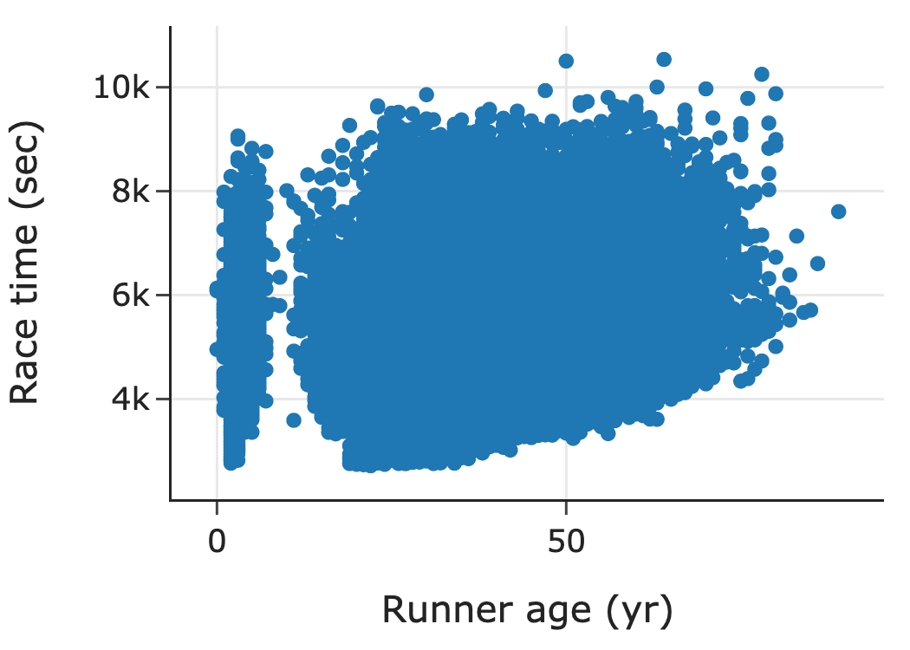
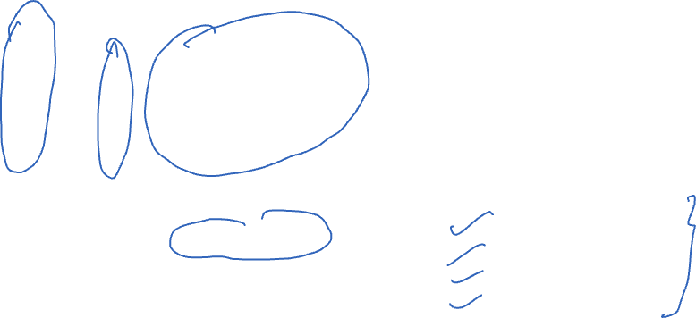
CHERRY BLOSSOM RUN
Scatter plot of run time (minutes) by age (years)
70,000 points in this plot.
What’s the relationship between run time and age?
Poll: what would be a better plot?
Hint: think about type of data
A. Histogram/density plot
B. Bar plot
C. Violin plot
D. Box plot
Note: This is a self-selected sample
Notes:
Overlaying Histogram/Density plot
Bar plot
Dot plot
Scatter plot
Box plot
Violin plot

Slide 28



Factors to consider in visualization: | Scale | Conditioning | Perception | Transformation | Context | Smoothing | Philosophy

Slide 29
SCALE
Factors to consider in visualization: | Scale | Conditioning | Perception | Transformation | Context | Smoothing | Philosophy

Slide 30

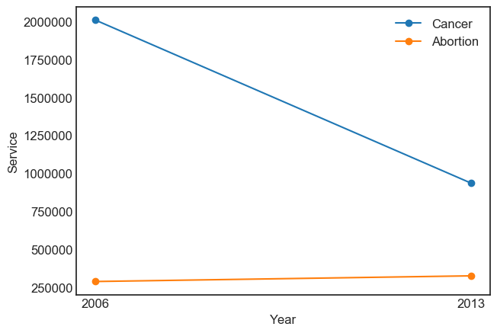
PLANNED PARENTHOOD PROCEDURES

Slide 31
PLANNED PARENTHOOD PROCEDURES
All points and lines are on the same scale
How does this plot change the perception of the information?
There has been a dramatic decrease in cancer screenings which dominates this plot
The scales of the two procedures are very different – consider representing as percentages instead
Remaining issue(s)?
Factors to consider in visualization: | Scale | Conditioning | Perception | Transformation | Context | Smoothing | Philosophy

Slide 32
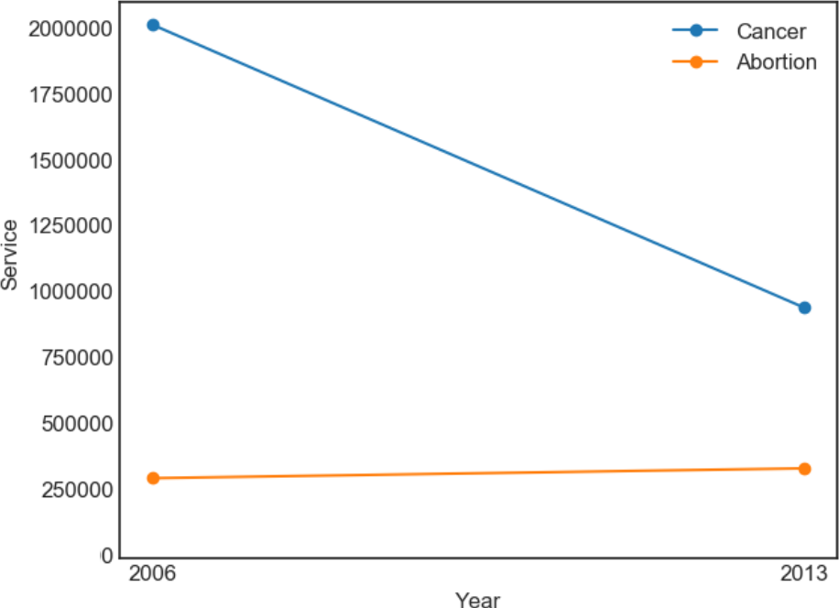
PLANNED PARENTHOOD PROCEDURES
Scales not starting at zero can give the false impression that values are farther away from each other.
Remaining issue(s)?

Slide 33
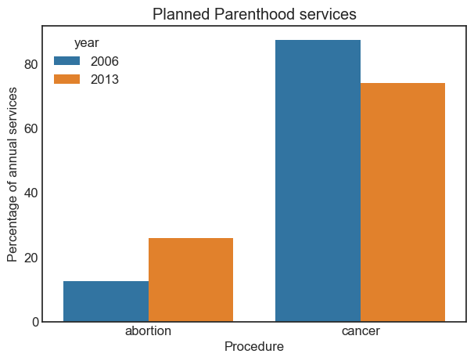
PLANNED PARENTHOOD PROCEDURES
Procedures in 2006 and 2013 as a percentage
Abortions increased from 13% to 26% of total procedures
May want to plot the percent change, screenings fell 50%
Scale | Conditioning | Perception | Transformation | Context | Smoothing | Philosophy

Slide 34

EARNINGS

Slide 35

EARNINGS
Emphasize the important difference
Lines make it easier to see growth in gap
Placement of one point above the other makes it easier to compare males & females
Good example of data exploration visualization (previous bar plot) vs. data presentation visualization (this plot)
Scale | Conditioning | Perception | Transformation | Context | Smoothing | Philosophy

Slide 36
PERCEPTION - COLOR
Scale | Conditioning | Perception | Transformation | Context | Smoothing | Philosophy

Slide 37

COLOR GUIDELINES
Choosing a set of colors which work well together is a challenging task for anyone who does not have an intuitive gift for color
7-10% of males are red-green color blind
Blue-yellow color blindness less common
Titanic Survivors
Scale | Conditioning | Perception | Transformation | Context | Smoothing | Philosophy

Slide 38


COLORFULNESS
Saturated/colorful colors are hard to look at for a long time.
They tend to produce an after-image eﬀect which can be distracting.
Scale | Conditioning | Perception | Transformation | Context | Smoothing | Philosophy

Slide 39

LUMINANCE
Areas should be rendered with colors of similar luminance (brightness)
Lighter colors tend to make areas look larger than darker colors
Scale | Conditioning | Perception | Transformation | Context | Smoothing | Philosophy

Slide 40



MATPLOTLIB’S VIRIDIS COLORMAP
Goal: a "perceptually uniform" colormap,
with uniform perceptual deltas
matplotlib.pyplot.viridis()
https://bids.github.io/colormap
Notes:
Left: Colormap and its grayscale version, perceptual deltas and perceptual lightness deltas.
We want property that if data goes from 0.1 to 0.2, this should have same perceptual change as if data goes from 0.8 to 0.9.
What a colorblind person would see
3D visualization of colormap spline through CAM02-UCS color space: "perceptually uniform" means that dots should be equally spaced
Right: Example images colored with the test colormap (left column) and how it would be perceived by readers with the most common form of color blindness (right column)
Deuteranopia – red-green colorblindness
Protanomaly – reduced sensitivity to red light

Slide 41
DATA TYPE AND COLOR
Categorical – Choose a scheme that makes it easy to distinguish between categories
Quantitative – Choose a color scheme that implies magnitude.
Does the data progress from low to high? Use a sequential scheme where light colors are for low values
Do both low and high value deserve equal emphasis? Use a diverging scheme where light colors represent middle values
Scale | Conditioning | Perception | Transformation | Context | Smoothing | Philosophy

Slide 42




COLORMAPS
https://matplotlib.org/examples/color/colormaps_reference.html
Scale | Conditioning | Perception | Transformation | Context | Smoothing | Philosophy

Slide 43
PERCEPTION - LENGTH

Slide 44
BAR PLOT, PIE CHART, DOT CHART
Experiments found that angle judgments based on pie charts are less accurate than length judgments from bar charts
Length is easier to compare than area or volume
Lengths that fall on a line are easier to compare than lengths on parallel lines, i.e., judgments based on dot charts are easier to make than judgments based on bar plots

Slide 45


Scale | Conditioning | Perception | Transformation | Context | Smoothing | Philosophy

Slide 46


WHICH OF THESE PLOTS IS EASIEST TO READ?
B
C
A

Slide 47
STACKING AND JIGGLING
Stacked bar plots and histograms are difficult to read because the base line moves from one bar to the next
Line plots where the area between successive lines represent the measurement are very difficult to read because the base line jiggles up and down.
Scale | Conditioning | Perception | Transformation | Context | Smoothing | Philosophy

Slide 48
CO2 EMISSIONS FROM FUEL CONSUMPTION
Data on historical carbon dioxide (CO2) emissions from fuel combustion (http://cait.wri.org)
Country annual CO2 emissions date back to 1850
Typical report on trends since 1950 for the 14 countries that emitted the greatest amount of CO2 in 2012
World Resources Institute (http://www.wri.org/)
Scale | Conditioning | Perception | Transformation | Context | Smoothing | Philosophy

Slide 49


CO2 EMISSIONS
Scale | Conditioning | Perception | Transformation | Context | Smoothing | Philosophy

Slide 50
TRANSFORMATIONS
Scale | Conditioning | Perception | Transformation | Context | Smoothing | Philosophy

Slide 51
WHY TRANSFORM VARIABLES?
Reveal distribution of most of the observations (otherwise much of the data is squashed in a small region)
Reveal anomalies on the “other side” of the data
Numerical summaries of transformed data are better summaries of a symmetric distribution
Logarithmic transformations are the most common especially when the numbers are large or too small.
Scale | Conditioning | Perception | Transformation | Context | Smoothing | Philosophy

Slide 52

BASIC FUNCTIONAL RELATIONS

Slide 53
Log transformation: Swiss army knife

Slide 54


LOGS AND COMPLEX RELATIONS KEPLER’S THIRD LAW (1619)
Scale | Conditioning | Perception | Transformation | Context | Smoothing | Philosophy

Slide 55

LOGS AND COMPLEX RELATIONS KEPLER’S THIRD LAW
Scale | Conditioning | Perception | Transformation | Context | Smoothing | Philosophy

Slide 56
ADD CONTEXT
Scale | Conditioning | Perception | Transformation | Context | Smoothing | Philosophy

Slide 57
ADD CONTEXT
Label axes, include units
Add Reference lines and markers for important values
Label points of unusual/interesting observations
Include captions that describe data, how plotted, and describe important features
Scale | Conditioning | Perception | Transformation | Context | Smoothing | Philosophy

Slide 58
LARGE N (RECORDS) SMOOTHING
Scale | Conditioning | Perception | Transformation | Context | Smoothing | Philosophy

Slide 59

SMOOTHING SCATTER PLOTS
Now we want to smooth the y-values as a function of x

Slide 60

SMOOTHING SCATTER PLOTS
For an x-value
consider all of the x’s near it
Take an average of the y-values

Slide 61

SMOOTHING SCATTER PLOTS
For an x-value
consider all of the x’s near it
Take an average of the y-values

Slide 62

SMOOTHING SCATTER PLOTS
Create bins for all x
Average y-values in each bin

Slide 63

SMOOTHING SCATTER PLOTS
These averages sketch out a curve

Slide 64
SMOOTHING DETOUR

Slide 65

http://scikit-learn.org/stable/modules/density.html

Slide 66

KERNEL DENSITY ESTIMATE: ALTERNATIVE SMOOTHER
Consider one point
Smooth it’s empirical mass with a kernel function,
rather than a histogram bin
Area under this curve is 1

Slide 67

KDE – 3 POINTS

Slide 68

KDE – 3 POINTS
Place a kernel
on each observation

Slide 69

KDE – 3 POINTS
The area under each of the
kernels is 1/3

Slide 70


KDE – 3 POINTS
Sum the 3 kernels at each point to get the density curve
K_{h} is the Kernel function
h refers to how peaked /spread the kernel is

Slide 71

SMOOTHING SCATTER PLOTS
Rather than a simple average in fixed bins
We use kernels positioned on the x_{i} to determine the weights to place on the y_{i} in the average
The denominator ensures the weights sum to 1

Slide 72

SMOOTHING SCATTER PLOTS
Rather than a simple average
We use kernels positioned on the x_{i} to determine the weights to place on the y_{i} in the average
The denominator ensures the weights sum to 1

Slide 73

SMOOTHING SCATTER PLOTS
For each x, we find g(x) by a weighted average of the y_{i}
The y_{i} are weighted according to the kernel function.
So x_{i} far from x do not contribute much to g(x)

Slide 74
LOCAL SMOOTHING
Moving window
Smooth/Average y values in the window
Many different approaches for doing this:
kernel methods (what we just showed),
cubic splines, thin plate splines,
Locally weighted smooth scatterplot (lowess)
Allows us to see shape of the relationship between y and x
Scale | Conditioning | Perception | Transformation | Context | Smoothing | Philosophy

Slide 75
CHERRY BLOSSOM RUN
3-dimensional histogram is needed, but hard to come by
Use heat map or hexbin plot or transparency or contour plot
Make a smooth curve that takes local averages to see the conditional center, i.e., average y in a neighborhood of x
Scale | Conditioning | Perception | Transformation | Context | Smoothing | Philosophy

Slide 76


CHERRY BLOSSOM RUN
Scale | Conditioning | Perception | Transformation | Context | Smoothing | Philosophy

Slide 77

CHERRY BLOSSOM RUN
Local Smoothing helps us see the typical run time for each age
We have controlled for year by making separate smooth curves for runners in each yearly race
Notice anything unusual?
Scale | Conditioning | Perception | Transformation | Context | Smoothing | Philosophy

Slide 78

CHERRY BLOSSOM RUN
How are the data generated?
All runners in each annual CB run from 1999 to 2012
Snapshots in time – one for each year – Runners in 1999 may be quite different than runners in 2012
If we control for year and only examine the relationship between time and age for 2012, we still have a problem. These are not longitudinal data where we follow the same people in time as they age.
Scale | Conditioning | Perception | Transformation | Context | Smoothing | Philosophy

Slide 79
PHILOSOPHY
Scale | Conditioning | Perception | Transformation | Context | Smoothing | Philosophy

Slide 80
REVEAL THE DATA
Choose scale appropriately
Avoid having other graph elements interfere with data
Use visually prominent symbols
Eliminate superfluous material, aka chart junk
Avoid over-plotting
Scale | Conditioning | Perception | Transformation | Context | Smoothing | Philosophy

Slide 81


AVOID OVER-PLOTTING
Jitter: Add random noise so the values aren’t plotted on top of each other
Why are there so few data points?
Shrink the plotting symbol so they don’t plot on top of each other
Scale | Conditioning | Perception | Transformation | Context | Smoothing | Philosophy

Slide 82
FACILITATE COMPARISONS
Put Juxtaposed plots on same scale
Make it easy to distinguish elements of superposed plots, e.g. with color, line type
Avoid Stacking and Jiggling the baseline
Avoid angles, extra dimensions (e.g., areas rather than lines)
Don’t break the visual metaphor, i.e., if use rectangles, then area should correspond to value
Scale | Conditioning | Perception | Transformation | Context | Smoothing | Philosophy

Slide 83
MAKE A PLOT INFORMATION RICH
Describe what you see in the Caption
Add context with Reference Markers (lines and points) including text
Add Legends and Labels
Use color and plotting symbols to add more information
Plot the same thing more than once in different ways/scales
Reduce clutter
Scale | Conditioning | Perception | Transformation | Context | Smoothing | Philosophy

Slide 84
CAPTIONS
Captions should be comprehensive
Self-contained
Captions should:
Describe what has been graphed
Draw attention to important features
Describe conclusions drawn from graph
Scale | Conditioning | Perception | Transformation | Context | Smoothing | Philosophy

Slide 85
GOOD PLOT MAKING PRACTICE
Put major (quantitative) conclusions in graphical form
Provide reference information
Proof read for clarity and consistency
Graphing is an iterative process
Multiplicity is OK, i.e., two plots of the same variable may provide different messages
Make plots data rich
Scale | Conditioning | Perception | Transformation | Context | Smoothing | Philosophy

Slide 86
UNIVARIATE DISPLAYS
Type | Plot
Quantitative | few observations Histogram, Density curve Box plot, Violin plot Normal quantile plot Few Observations - Rug plot, Dot plot Caution if discrete: density curves and box plots may be misleading
Categorical – Counts of categories | Dot chart Bar chart Pie chart (avoid!) Caution if ordinal –order of bars, dots, etc. should reflect category order

Slide 87
BIVARIATE DISPLAYS
 | Quantitative/Numeric | Categorical
Quantitative | Scatter plot Smooth scatter Contour plot Smooth lines and curves | Multiple histograms, density curves, Avoid jiggling!
Categorical |  | Side-by-side bar plot Overlaid Lines plot Side-by-side dot chart Mosaic plot Avoid stacking!

Slide 88
ACKNOWLEDGMENTS
These slides use materials by Berkeley’s DS 100 team, Isabel Cruz, Jiawei Han, Micheline Kamber, Jian Pei, and Elena Zheleva

